Slide 1
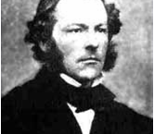
Chapter 3
The Mean Value Theorem and Applications of Derivatives

Slide 2
Overview
The Mean Value Theorem
L’ Hospital Rules
Tayor’s Theorem
Applications of Derivatives

Slide 3
Section 3.1
The Mean Value Theorem

Slide 4
Mean Value Theorem in Differential Calculus
Suppose and the corresponding figure is
It is easy to see that there exist at least one point in the interval , such that
.

Slide 5
Mean Value Theorem in Differential Calculus
Lemma (Fermat lemma)
Suppose and is differentiable
at the point .
If is a local maximum (minimum)
of the function
that is ,
we have
(or )
then
.
Proof
Suppose that ,
.
Since function is differentiable
at the point ,
we have
.
By the definition of derivative,
we have
,
.

Slide 6
Mean Value Theorem in Differential Calculus
,
Proof (continued)
,
since ,
we have ,
thus
.
When , .
Thus
.
And then, we have
.
It is similar that this conclusion holds when
Finish.

Slide 7
Mean Value Theorem in Differential Calculus
Note We can’t expect to locate extreme values simply by setting
and solving for x.
Example
f has no maximum or minimum at 0.

Slide 8
Mean Value Theorem in Differential Calculus
Theorem (Rolle’s theorem) If satisfies the following conditions:
(1) f is continuous on the interval ;
(2) f is differentiable in the interval ;
(3) ,
then, there exists at least one point , such that .

Slide 9
Mean Value Theorem in Differential Calculus
Proof
Since function f is continuous on the interval [a,b],
then,
there exist
, such that
.
1) If ,
then f is a constant
and hence we have , .
2) If ,
then at least one of M and m is not equal to f(a) ,
since
; suppose
, so that .
Then the maximum
value M must be achieved at a point .
This means that
, and ,
such that , .
Then by the Fermat’s lemma, .
Finish.

Slide 10
Mean Value Theorem in Differential Calculus
Note If any one of the three conditions is not satisfied then the conclusion of Rolle’s theorem is not necessarily true.
Example
y
1
O
1
x

Slide 11
Mean Value Theorem in Differential Calculus
Example Prove that the equation has one and only one real root in the interval .
Proof Let ,
then f is continuous on and
.
By the zero theorem for continuous functions
we know
that f has at least one zero point in the interval
and this point is
denoted by .
We now prove the zero point of in (-1, 0) is unique.
Suppose it is not true, that is,
there is another zero point
(say ).
Then, there must be at least one point
such that .
This is impossible since ,
and then the conclusion holds.
Finish.

Slide 12
Mean Value Theorem in Differential Calculus
Example Suppose that the function is continuous on the interval
,
and differentiable in ,
Prove that there exists at least one
,
such that
.
Analysis
Try to apply Rolle’s theorem to function F(x).
Since ,
it is enough to prove
Notice that
so,
if we can prove there has a ,
such that ,
the statement can be held.

Slide 13
Mean Value Theorem in Differential Calculus
Proof:
Let .
Obviously, F(x) is continuous on
and differentiable
in ;
by assumption,
and
Hence by Rolle’s theorem, there exists at least one point ,
such that
,
or
.
Finish.

Slide 14
Mean Value Theorem in Differential Calculus
The tangent line to the cure y = f (x) at the points C₁ and C2 are parallel to line AB.

Slide 15
Mean Value Theorem in Differential Calculus
More generally, if ,
by the following graph,
there may have a point
, such that the tangent line at
parallel to the line connected
point A and B.

Slide 16
Mean Value Theorem in Differential Calculus
h
Theorem (Lagrange’s theorem) If satisfies
(1) f is continuous on the interval ;
(2) f is differentiable in the interval ;
then, there exists at least one point , such that
Lagrange Formula
or

Slide 17
Mean Value Theorem in Differential Calculus
Analysis
It is enough to prove that there exists a , such that
Notice that
and is a straight line through the origin 0 and parallel to
the line connected point and .
So that the difference
must be equal at the two end points.
This analysis inspire us to construct
Auxiliary Function
and to apply Rolle’s theroem.

Slide 18
Mean Value Theorem in Differential Calculus
Auxiliary Function
Proof:
Let
.
F(x) is continuous on [a, b] and differentiable in (a, b). Also,
so that F(a) = F(b).
By Rolle’s theorem ,
we obtain that there exists
at least one point
such that
or

Slide 19
Mean Value Theorem in Differential Calculus
Note When f (a) = f (b), the Lagrange theorem is Rolle’s theorem. So, Lagrange theorem is a generalization of Rolle’s theorem.
Note The Lagrange theorem has some other forms. Since ,
Let ;
then and .
Thus the Lagrange
formula may be written as
If we choose and ,
then the Lagrange formula
may also be written as

Slide 20
Mean Value Theorem in Differential Calculus
h
Corollary Suppose that the function
is continuous and differentiable
on the interval I.
Then the necessary and sufficient condition for
on I
is that f is a constant on I.
Proof
The sufficiency is obvious.
We now prove the necessity.
Suppose
,
.
Take any
two points
,
and apply the Lagrange theorem on the interval
(or
)
There exists at least one
(or
)
, such
that
So that
is a constant on
.

Slide 21
Mean Value Theorem in Differential Calculus
Example
Prove that
Example Suppose that the functions
f , g are differentiable
in the interval
and
Prove that

Slide 22
Mean Value Theorem in Differential Calculus
Example
Prove the following inequality
Proof
We choose an auxiliary function
It is easy to check that the auxiliary function f (x) satisfies the
conditions of the Lagrange theorem on the interval [0, x]
and
hence there exists at least one point
such that

Slide 23
Mean Value Theorem in Differential Calculus
Example
Prove the following inequality
Proof (continued)
Notice that
so
Since
we have

Slide 24
Mean Value Theorem in Differential Calculus
Example
Suppose that the function
is differentiable,
Prove that the function f has a unique fixed point
Proof
We first prove f has at least one fixed point in (0,1).
Let
Since the functions f and x are both continuous on [0,1], F(x) is continuous
on [0,1].
From the assumption 0< f <1, we have
By the zero theorem we know that
there exists at lest one point
such that
that is

Slide 25
Mean Value Theorem in Differential Calculus
Example
Suppose that the function
is differentiable,
Prove that the function f has a unique fixed point
Proof (continued)
We prove f has at most one fixed point in (0,1).
Suppose f has two fixed points in x₁, x₂ in (0,1), and that means
We may assume
Applying the Lagrange theorem to f on
[x₁, x₂]
we know that
there exists at lest one point
such that
This contradicts our assumption.
Then we obtain our conclusion.

Slide 26
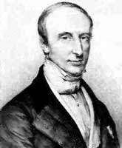
Mean Value Theorem in Differential Calculus
Theorem (Cauchy’s theorem)
Suppose that
,
, satisfy, the
following conditions:
both are continuous on the interval
;
(2) both are differentiable in the interval
;
(3)
,
.
Then there exists at least one point
such that
.
Cauchy, Augustin
(1789-1857)
French mathematician

Slide 27
Mean Value Theorem in Differential Calculus
Proof
By the assumption
,
, we have
. Therefore,
it is enough to prove that there exists at least one
such that
or
Let
It is easy to check that
satisfies all the conditions of Rolle’s theorem on the interval
, so that there
exists at least one point
, such that
and this is the equality we want.
Finish.

Slide 28
Review
Rolle’s Theorem
Lagrange’s Theorem
Cauchy’s Theorem

Slide 29
Section 3.2
L’ Hospital’s Rule

Slide 30
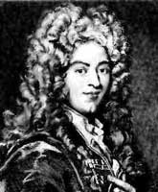
L’ Hospital’s Rules
Theorem (L’ Hospital’s rules I)
Suppose that f , g, are both differentiable in
and
.
If the following conditions hold
(1)
;
(2)
(
is a finite number or infinity),
then
L'Hospital, Guillaume de
(1661-1704)
French mathematician
This rule is also valid for
,
, and
.

Slide 31
L’ Hospital’s Rules
Proof
Since
, when f (x) and (or) g (x) are
discontinuous at
. We define
and
Choose any point
. It is easy to see that the conditions of the
Cauchy theorem are all satisfied for the functions F (x) and G (x) on the
interval between the points
and x.
Hence
,
where
lies between
and
.

Slide 32
L’ Hospital’s Rules
Proof (continued)
Let
, so that
, and the assumption
means
.
So,
.
Finish.
.

Slide 33
L’ Hospital’s Rules
Example Find
Solution
It is easy to check that the conditions of L’Hospital’s rules
are satisfied for the function
and
By L’Hospital’s rules,
we have
Finish.

Slide 34
L’ Hospital’s Rules
Example Find
Solution
It is easy to check that the conditions of L’Hospital’s rules
are satisfied for the function
and
By L’Hospital’s rules,
we have
Finish.

Slide 35
L’ Hospital’s Rules
Example Find
Solution
Finish.

Slide 36
L’ Hospital’s Rules
Example Find
.
Solution
Notice that when
, and
,
taking the limit of the factor
whose value is not zero and
replacing the infinitesimal
by its equivalent infinitesimal
, and then applying L’Hospital’s rule, we obtain
Finish.

Slide 37
L’ Hospital’s Rules
Theorem (L’ Hospital’s rules II )
Suppose that f , g, are both differentiable in
and
.
If the following conditions hold
(1)
;
(2)
(
is a finite number or infinity),
then
This rule is also valid for
,
, and
.

Slide 38
L’ Hospital’s Rules
Example Find
Solution
Example Find
Solution

Slide 39
L’ Hospital’s Rules
Example Find
Solution
×
Does not exist.
Note
(
is a finite number or infinity)

Slide 40
Indeterminate Forms
We will give some examples to show how to do with these types of indeterminate form.

Slide 41
Indeterminate Forms
Example Find
(
)
Solution:
Since
, this becomes the type
as
. By L’Hospital’s rule we have
Finish.

Slide 42
Indeterminate Forms
Example Find
.
)
Solution:
Since
, and this type is
.
By L’Hospital’s rule
we have
Finish.

Slide 43
Indeterminate Forms
Example Find
(
)
Solution: Since
, and
is of type
,
we have
Thus,
Finish.

Slide 44
Indeterminate Forms
Example Find
(
)
Solution: Since
, and
is of type
,
we have
Thus,
Finish.

Slide 45
Indeterminate Forms
Example Find
Solution: 1) Since
By Heine theorem,
2) Since
So,
Finish.

Slide 46
Exercises
1) Find
2) Find
3) Find
4) Find

Slide 47
Review
L’Hospital’s rules
Find Limit by using L’Hospital’s rules

Slide 48
Section 3.3
Taylor’s Theorem

Slide 49
Overview
In Chapter 2, we had seen that the value of a smooth function for some
variable x in
, where
is a fixed point , can be calculated simply
by approximation
.
This approximation is simple and is easily used, but it has low precision, since
the difference between the accurate value of
and the approximation is
just a infinitesimal of higher order with respect to
, and also this
approximation can only be used in the case of
is very small.
In this lecture, we will form a new technique to approximate the value of a function with higher order of computation error.

Slide 50
Taylor’s Theorem
It is easy to see that the approximation,
, in fact,
is using a line,
, to approximate a curve
. It can be
imaged that if we use a suitable curve to approximate curve
, the applicable
will be wider and the precision will be improved. It seems nature that we chose
the polynomials as the suitable curve.
Then the question becomes to, we try to
find a suitable polynomials of degree
to approximate a given curve of function
, such that the approximate error is
an infinitesimal of higher order with respect to
. That is
.
If we can do so, what are the coefficients of
, and how can we obtain
them?

Slide 51
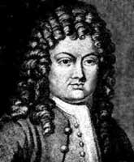
Taylor’s Theorem
Theorem (Taylor’s theorem with Peano remainder)
Suppose that the function f is differentiable of
order n at the point x₀. Then
Taylor coefficients
Taylor, Brook
(1685-1731)
English mathematician
Taylor Polynomial
Peano remainder
Notes:
The proof can be seen in the textbook. If the student can know the conclusion, it is enough for our student.

Slide 52
Taylor’s Theorem
Taylor, Brook
(1685-1731)
English mathematician
Lagrange Formula
Lagrange remainder
Notes:
The proof can be seen in the textbook. If the student can know the conclusion, it is enough for our student.

Slide 53
Taylor’s Theorem
Compare to the Peano remainder, the Lagrange remainder can be used to estimate the error more precisely.
In fact, if the function f is differentiable of order n+1 on [a, b], and there is a constant
such that
,
,
then
.
We can see from the inequality that
as
. This means that
if we utilize the polynomial
to approximate a differentiable function
of any order in the whole interval
, the error may be make arbitrarily
small
while
is taken large enough.

Slide 54
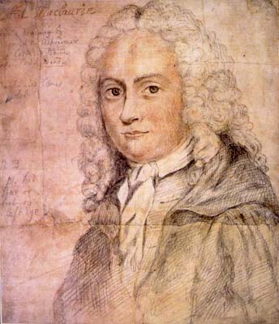
Taylor’s Theorem
If we let
, then the Lagrange formula becomes
and this formula is called the Maclaurin formula.
Colin Maclaurin
(1698 - 1746)
Scottish mathematician

Slide 55
Maclaurin Formulae for Some Elementary Functions
Maclaurin formula for the exponential function
Since
and
,
we have
where
and
.

Slide 56
Maclaurin Formulae for Some Elementary Functions
Maclaurin formula for
and
Let
, since
or
,
we have
then
where
and
.

Slide 57
Maclaurin Formulae for Some Elementary Functions
Maclaurin formula for
and
Similarly, we have
where
and
.

Slide 58
Maclaurin Formulae for Some Elementary Functions
Maclaurin formula for
We had known that
so
Thus
Where
and
.

Slide 59
Maclaurin Formulae for Some Elementary Functions
Maclaurin formula for
We had known that
so
Thus
Where
and
.

Slide 60

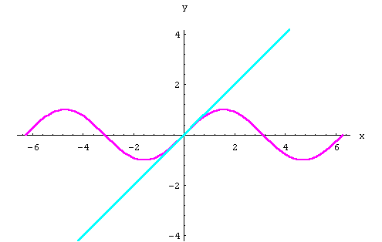
Some Applications of Taylor’s Theorem
(1) Approximate calculations

Slide 61
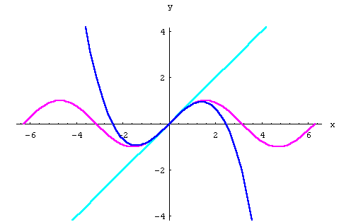
Some Applications of Taylor’s Theorem
(1) Approximate calculations

Slide 62
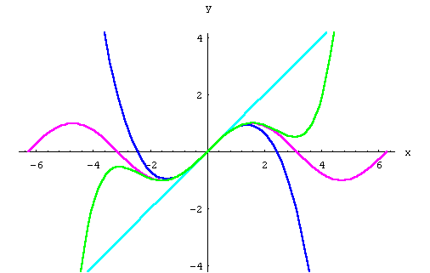
Some Applications of Taylor’s Theorem
(1) Approximate calculations

Slide 63
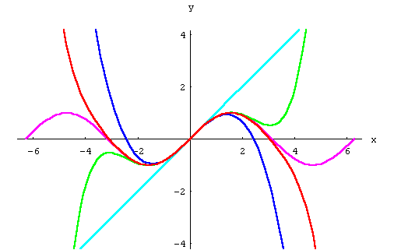
Some Applications of Taylor’s Theorem
(1) Approximate calculations

Slide 64
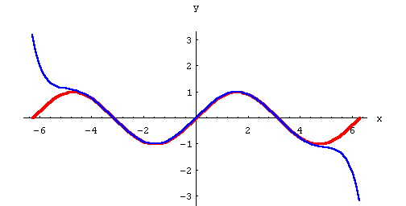
Some Applications of Taylor’s Theorem
(1) Approximate calculations

Slide 65
Some Applications of Taylor’s Theorem
(1) Approximate calculations
Example Approximate calculation of the value of
and estimation of the error.
Solution
Let
in the maclaurin formulae for
, we have
since
, so
It may be seen that
, as
, which means that
is approximated
by the approximation formula:
The error can be made arbitrarily small as long if
is taken large enough.
Finish.

Slide 66
Some Applications of Taylor’s Theorem
(1) Approximate calculations
Solution:
Since the error of approximation of Taylor is
when
lies between the points
and
. Since
and
for all
, we know that the error in the approximation is no more than
.
In order to have
, we only need
.

Slide 67
Some Applications of Taylor’s Theorem
(1) Approximate calculations
Example Find an approximate value of a real root for the equation
where
is a very small parameter.
Solution
It is easy to prove that this equation has a real root and it is dependent
on the parameter
; we denote this root by
. This function can be seen
as an implicit function determined
by the given function.
It can be prove that
the implicit function
is differentiable to any order. Thus, by Taylor
formula and taking for instance,
, we obtain
.

Slide 68
Some Applications of Taylor’s Theorem
(1) Approximate calculations
Example Find an approximate value of a real root for the equation
where
is a very small parameter.
Solution (continued)
We will determine the coefficients in the last equation. Take
, we have
, that is
.
We take different to each side of the given
equation with respect to
, we have
so that
Differentiating both sides of the given equation again, we have

Slide 69
Some Applications of Taylor’s Theorem
(1) Approximate calculations
Example Find an approximate value of a real root for the equation
where
is a very small parameter.
Solution (continued)
So that
therefore, the second degree approximate of the real root is
.
Finish.

Slide 70
Some Applications of Taylor’s Theorem
(2) Finding limits
Example Find
Solution
By Maclaurin formula with Peano remainder to
, we have
Finish.

Slide 71
Some Applications of Taylor’s Theorem
(2) Finding limits
Example Find
.
Solution
By Maclaurin formula with Peano remainder to cos x and e^{x},
we have
Finish.

Slide 72
Some Applications of Taylor’s Theorem
(3) Proving inequalities
Proof
By the Maclaurin formula we have
,
lies between and .
On the other hand, by the assumption we know
.
Thus,
.
Then, we have
and .

Slide 73
Some Applications of Taylor’s Theorem
(3) Proving inequalities
Proof (continued)
So that
Since
, we have
as
.
Finish.
Similarly, we can prove that if
then
, while
.

Slide 74
Review
Taylor’s theorem
Taylor’s theorem with Peano remainder
Taylor’s theorem with Lagrange remainder
Maclaurin formulae for some elementary functions
e^{x} sinx cosx ln(1+x) (1+x)ª
Some applications of Taylor’s theorem
Approximate calculations
Finding limits
Proving inequalities

